Slide 1
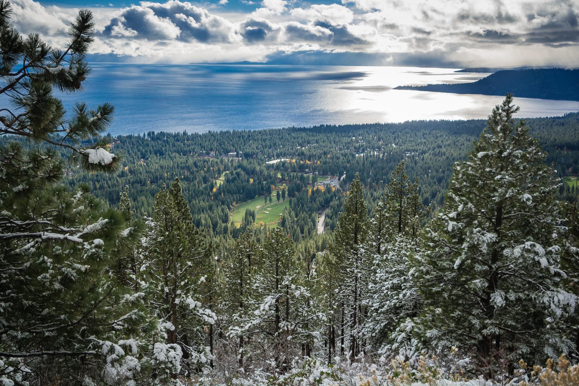
SOCIAL IMPACT OF COVID-19
STACY CALDWELL, Chief Executive Officer
ALISON SCHWEDNER, CCTT Director
PHYLLIS MCCONN, Community Impact Officer
January 5, 2021

Slide 2
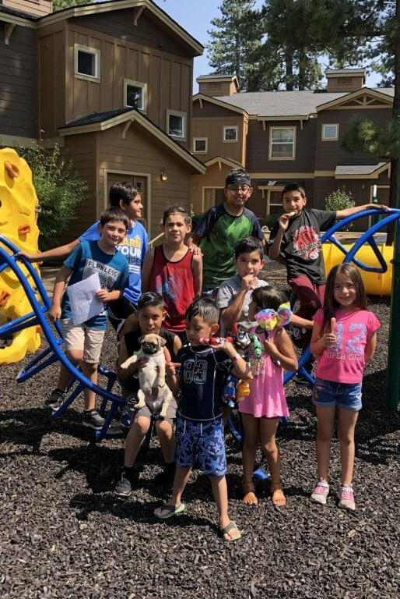
OUTLINE
Our Mission
Board & Staff
What We Do
Community Impact
Nonprofit Impact
Safety-Net Overview
Collective Giving
Regional Stewardship

Slide 3
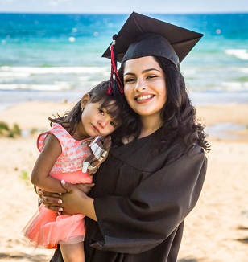
OUR MISSION
To connect people and opportunities, generating resources to build a more caring, creative, and effective community
Notes:
Stacy

Slide 4
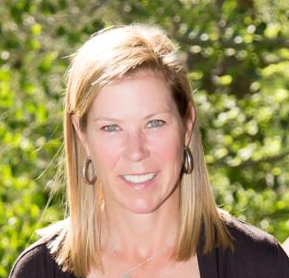
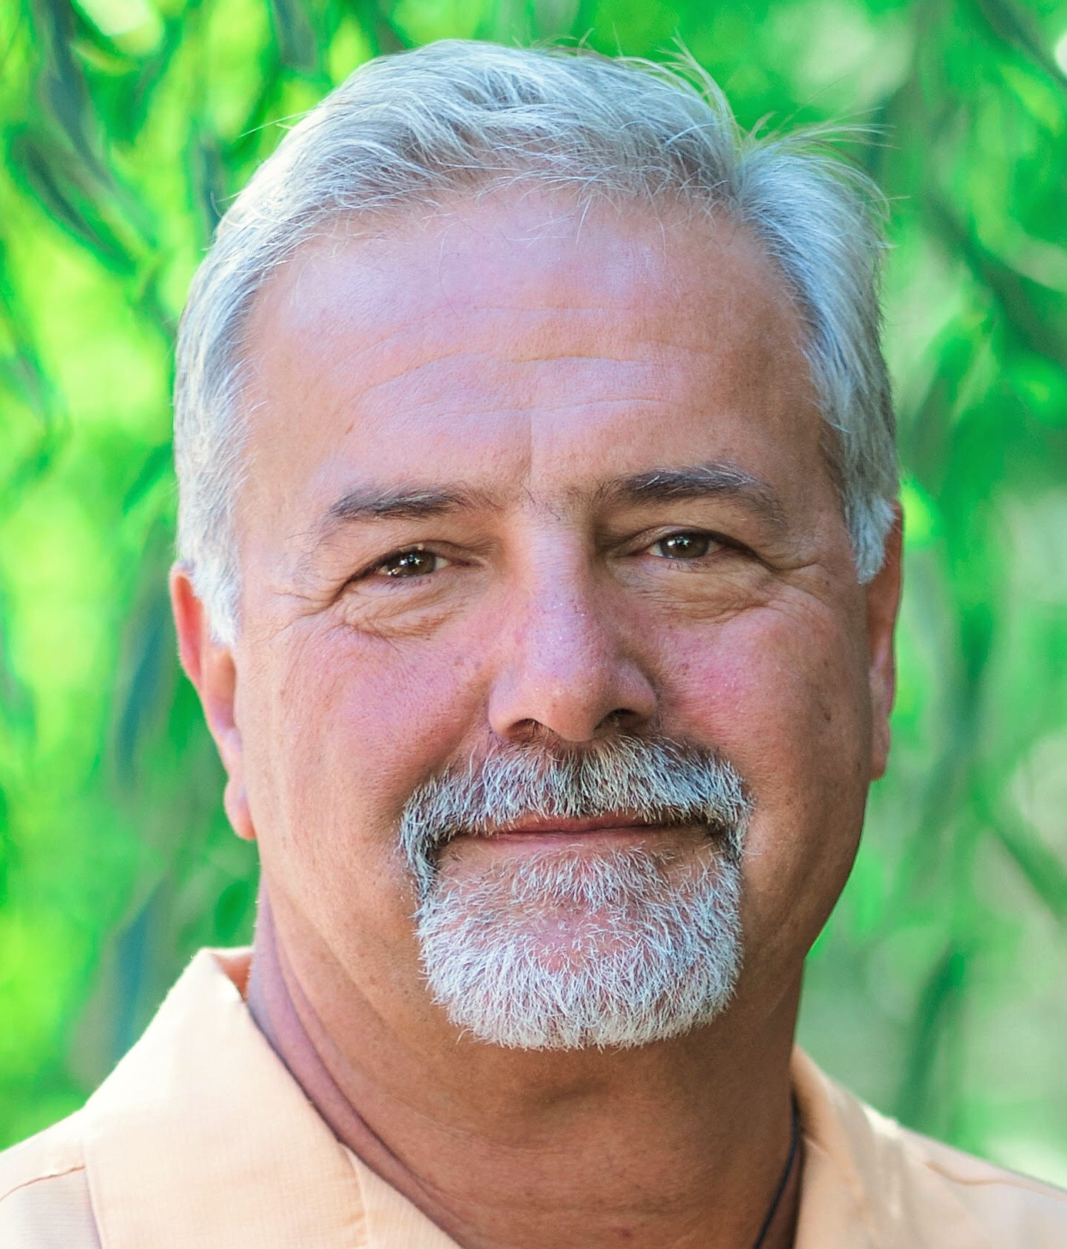
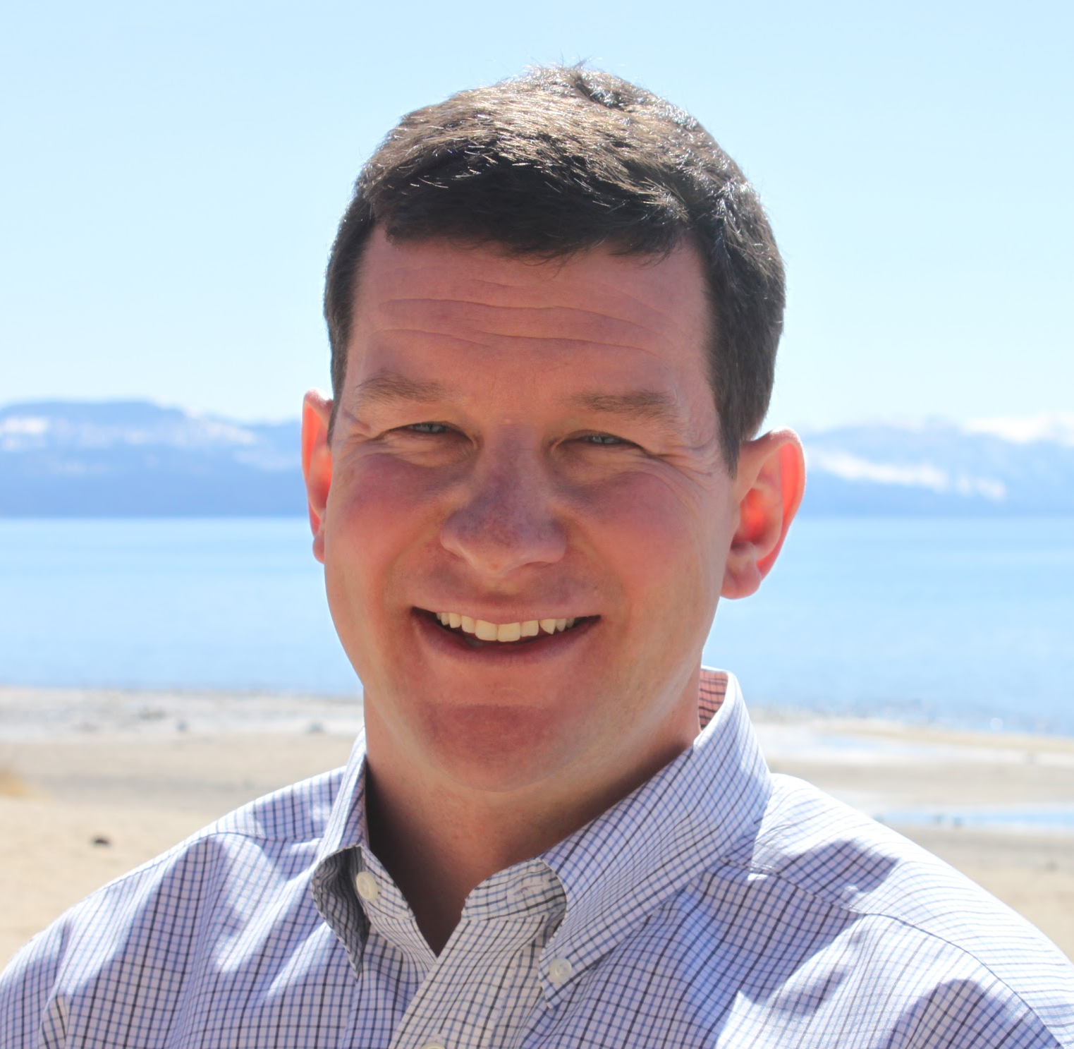
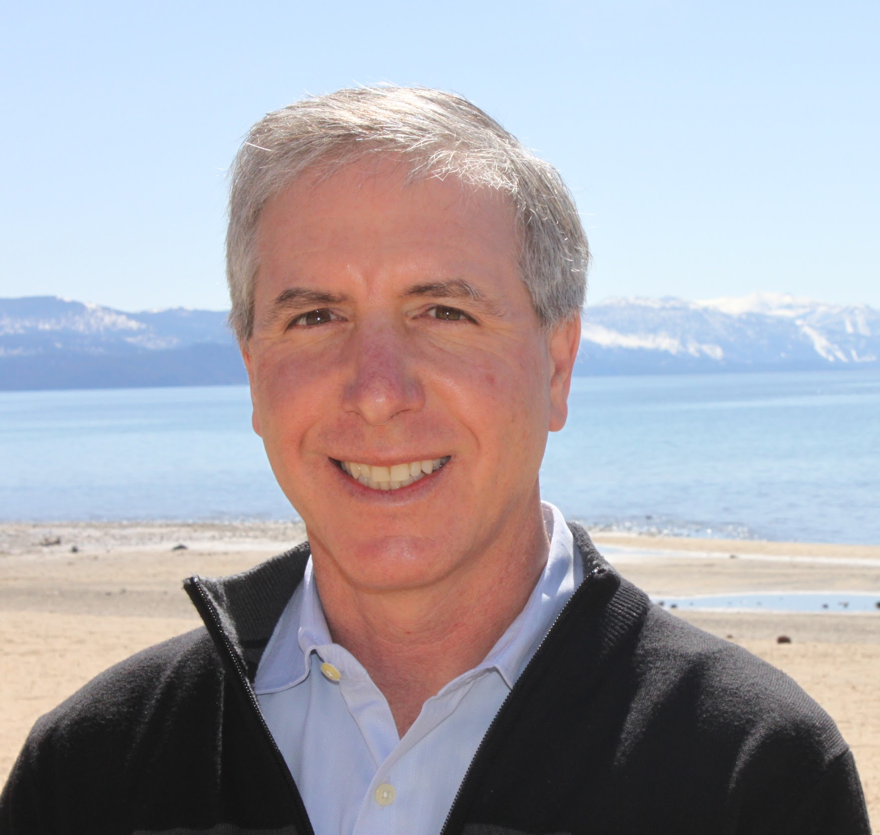
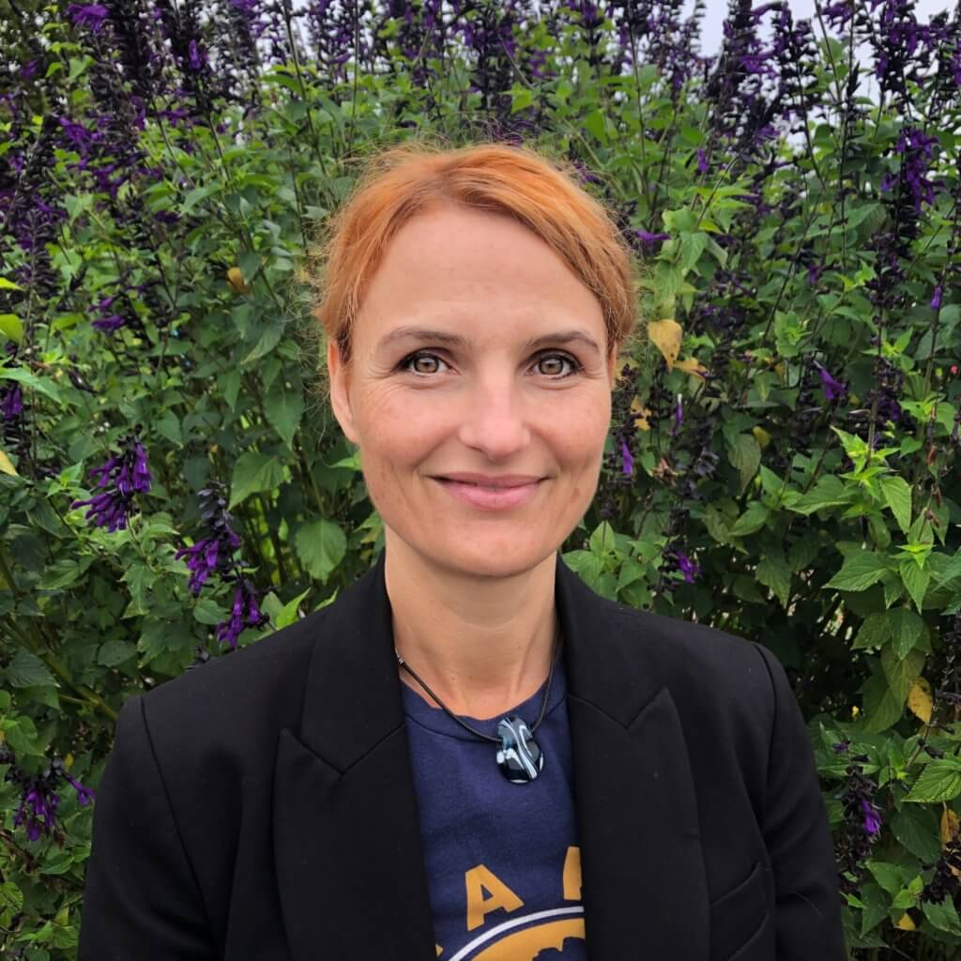
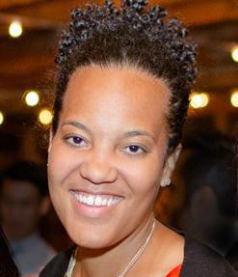
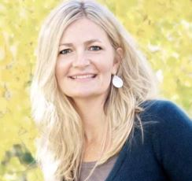
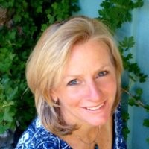
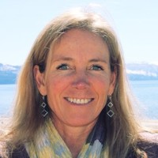
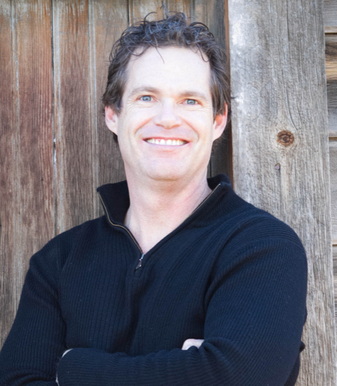
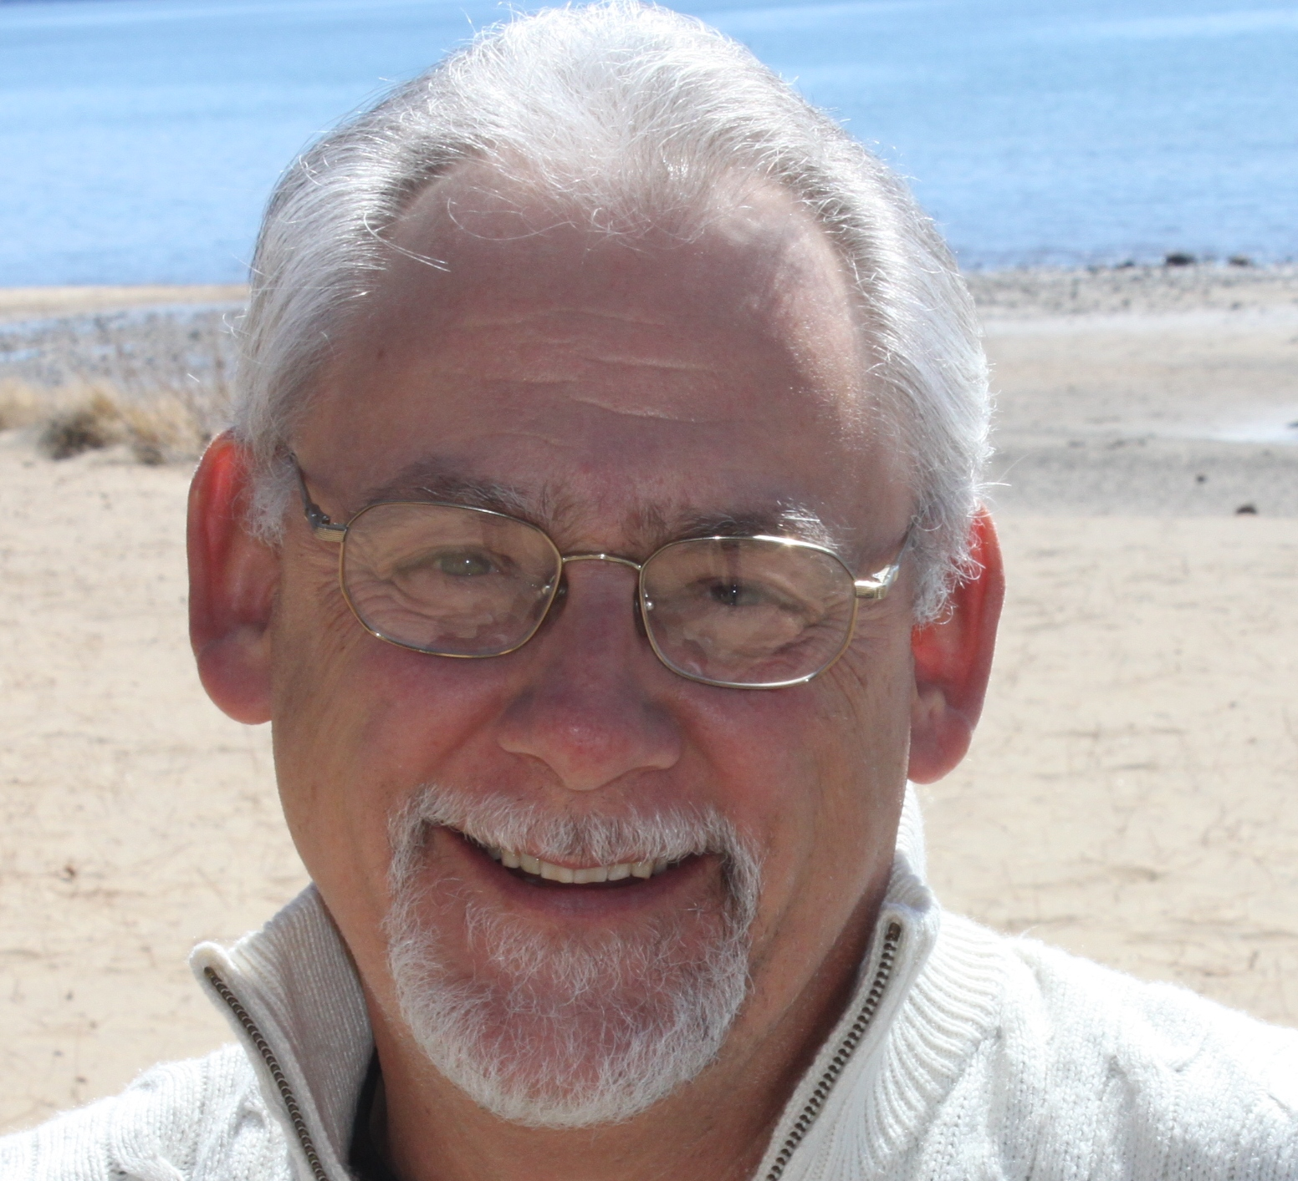
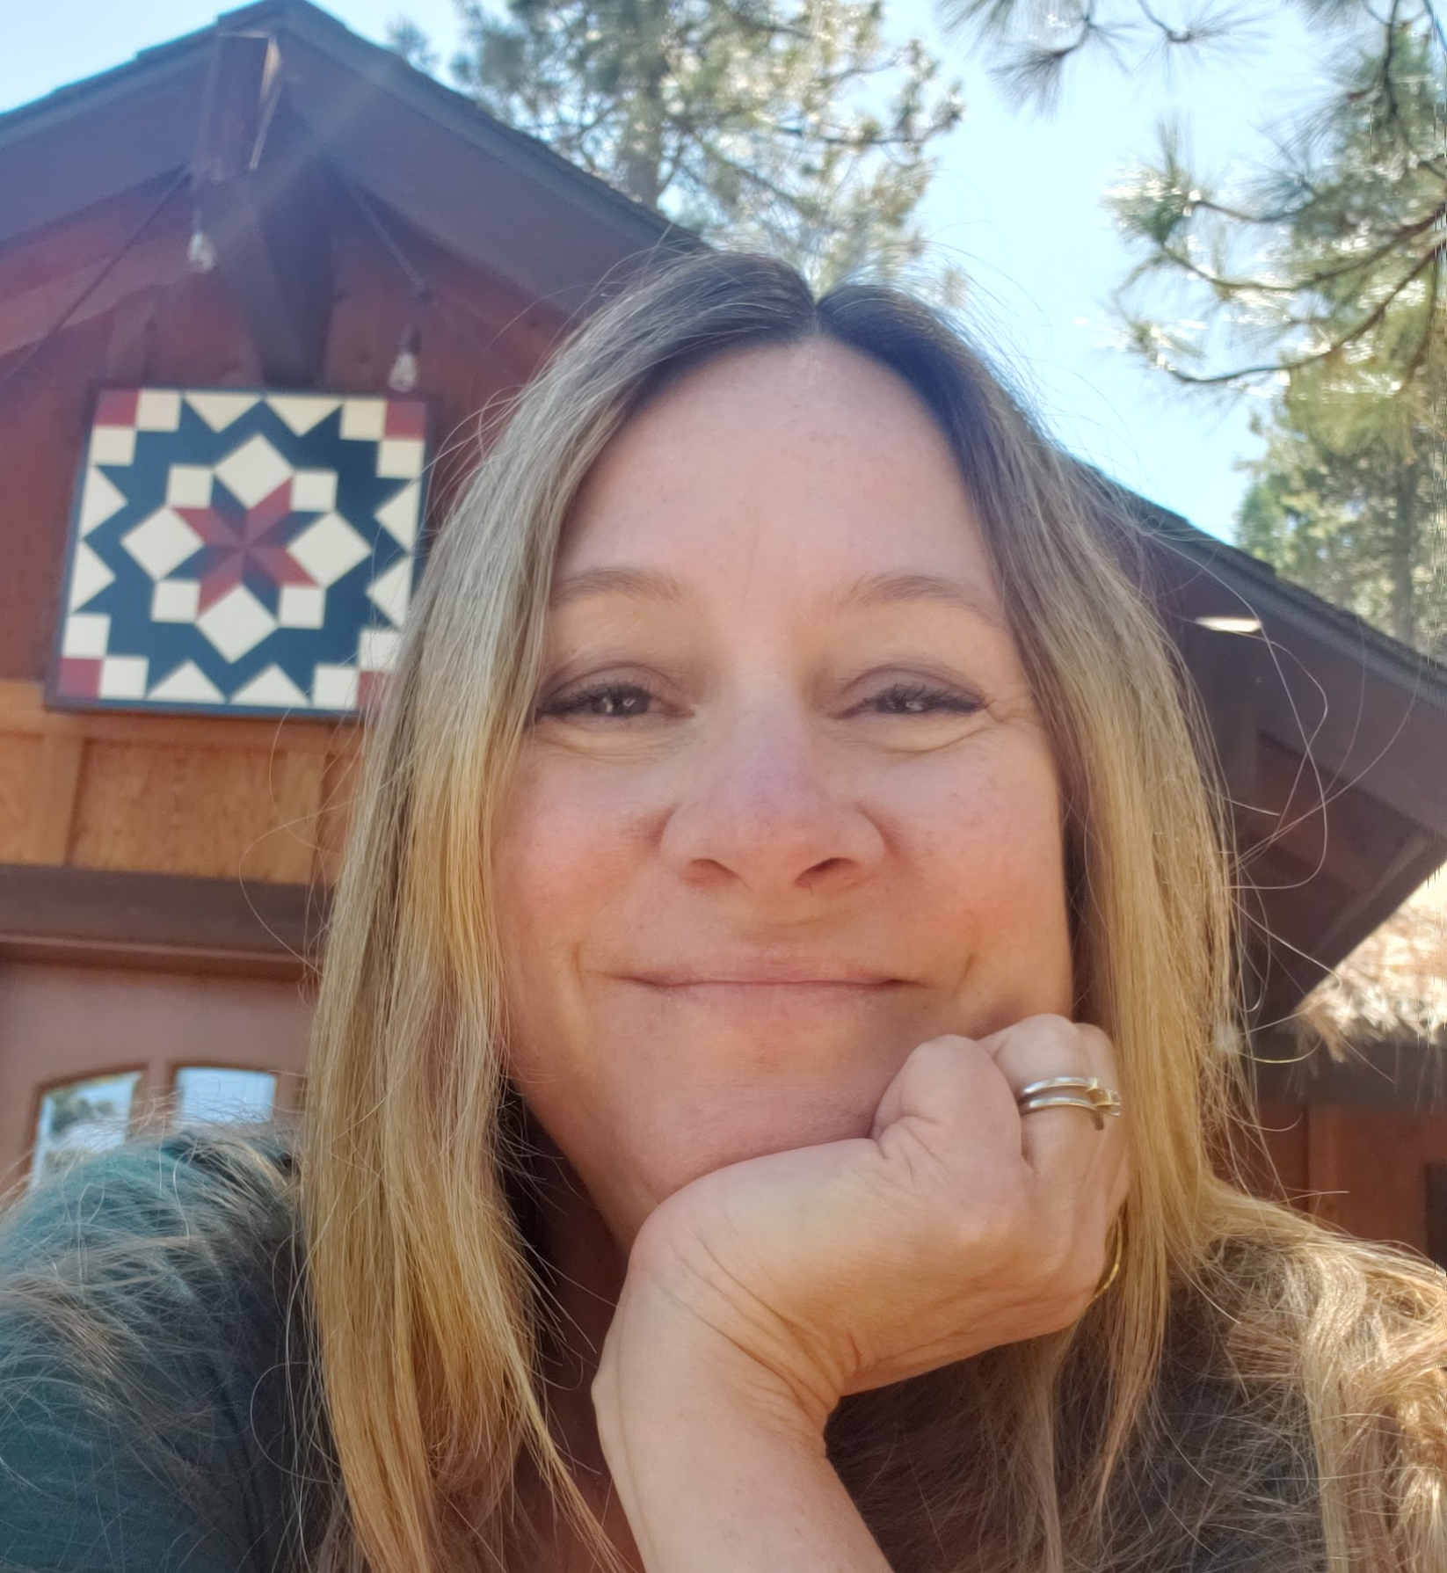
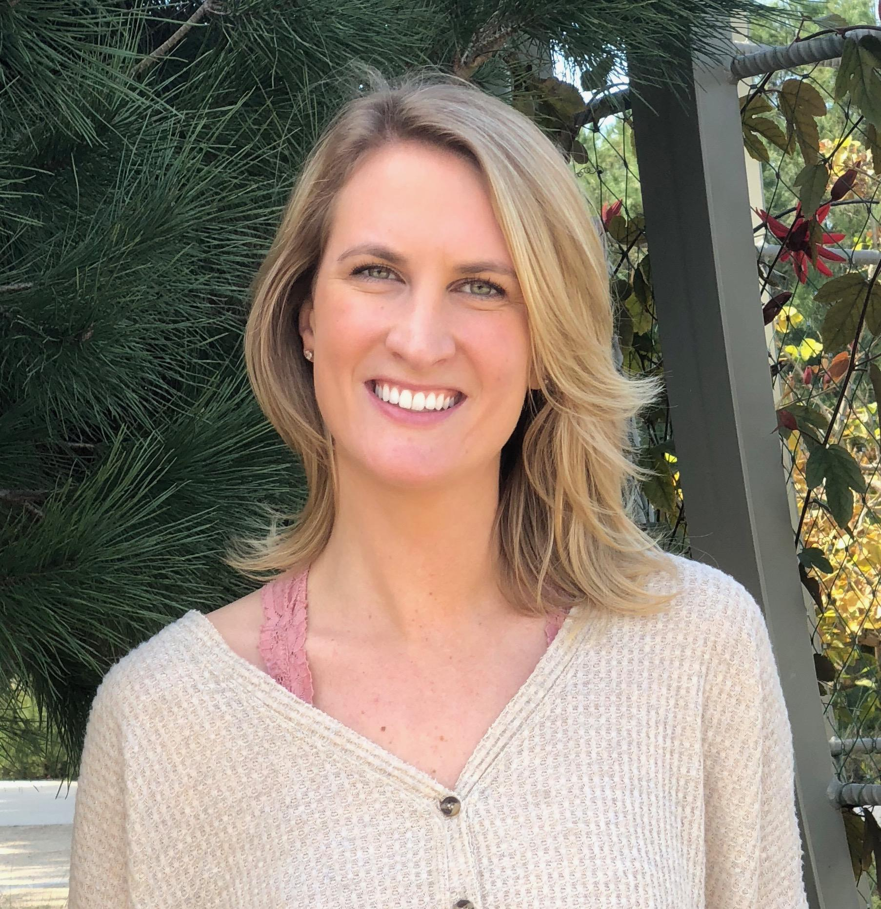
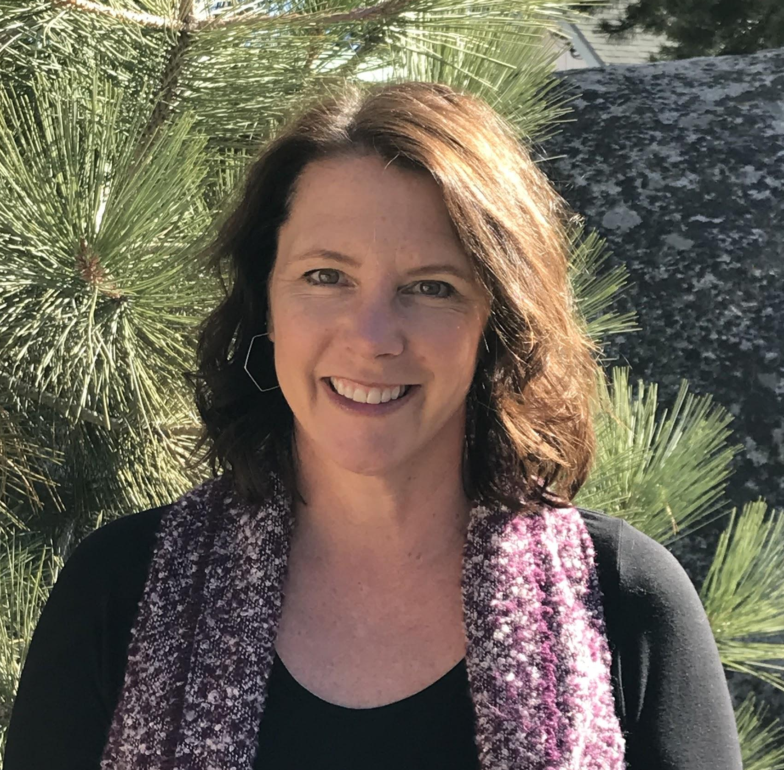
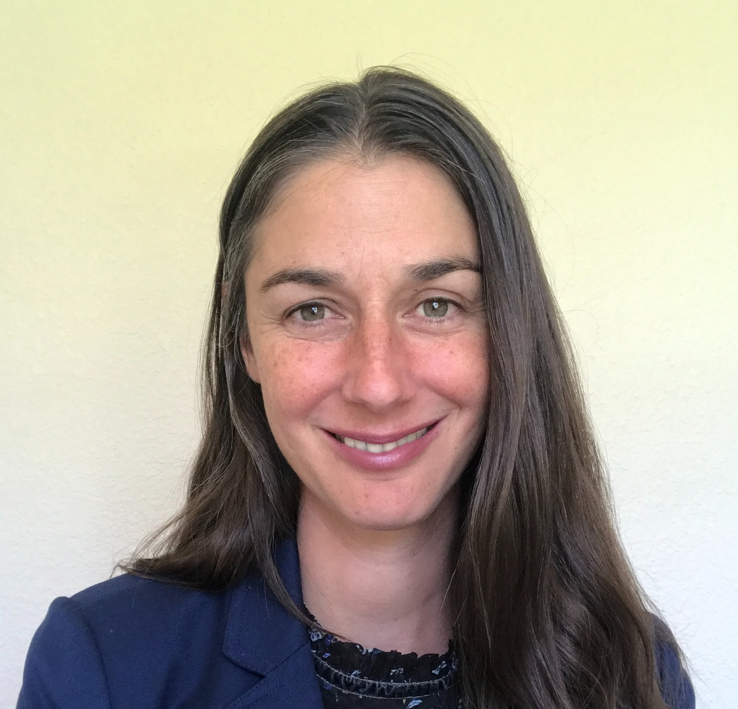
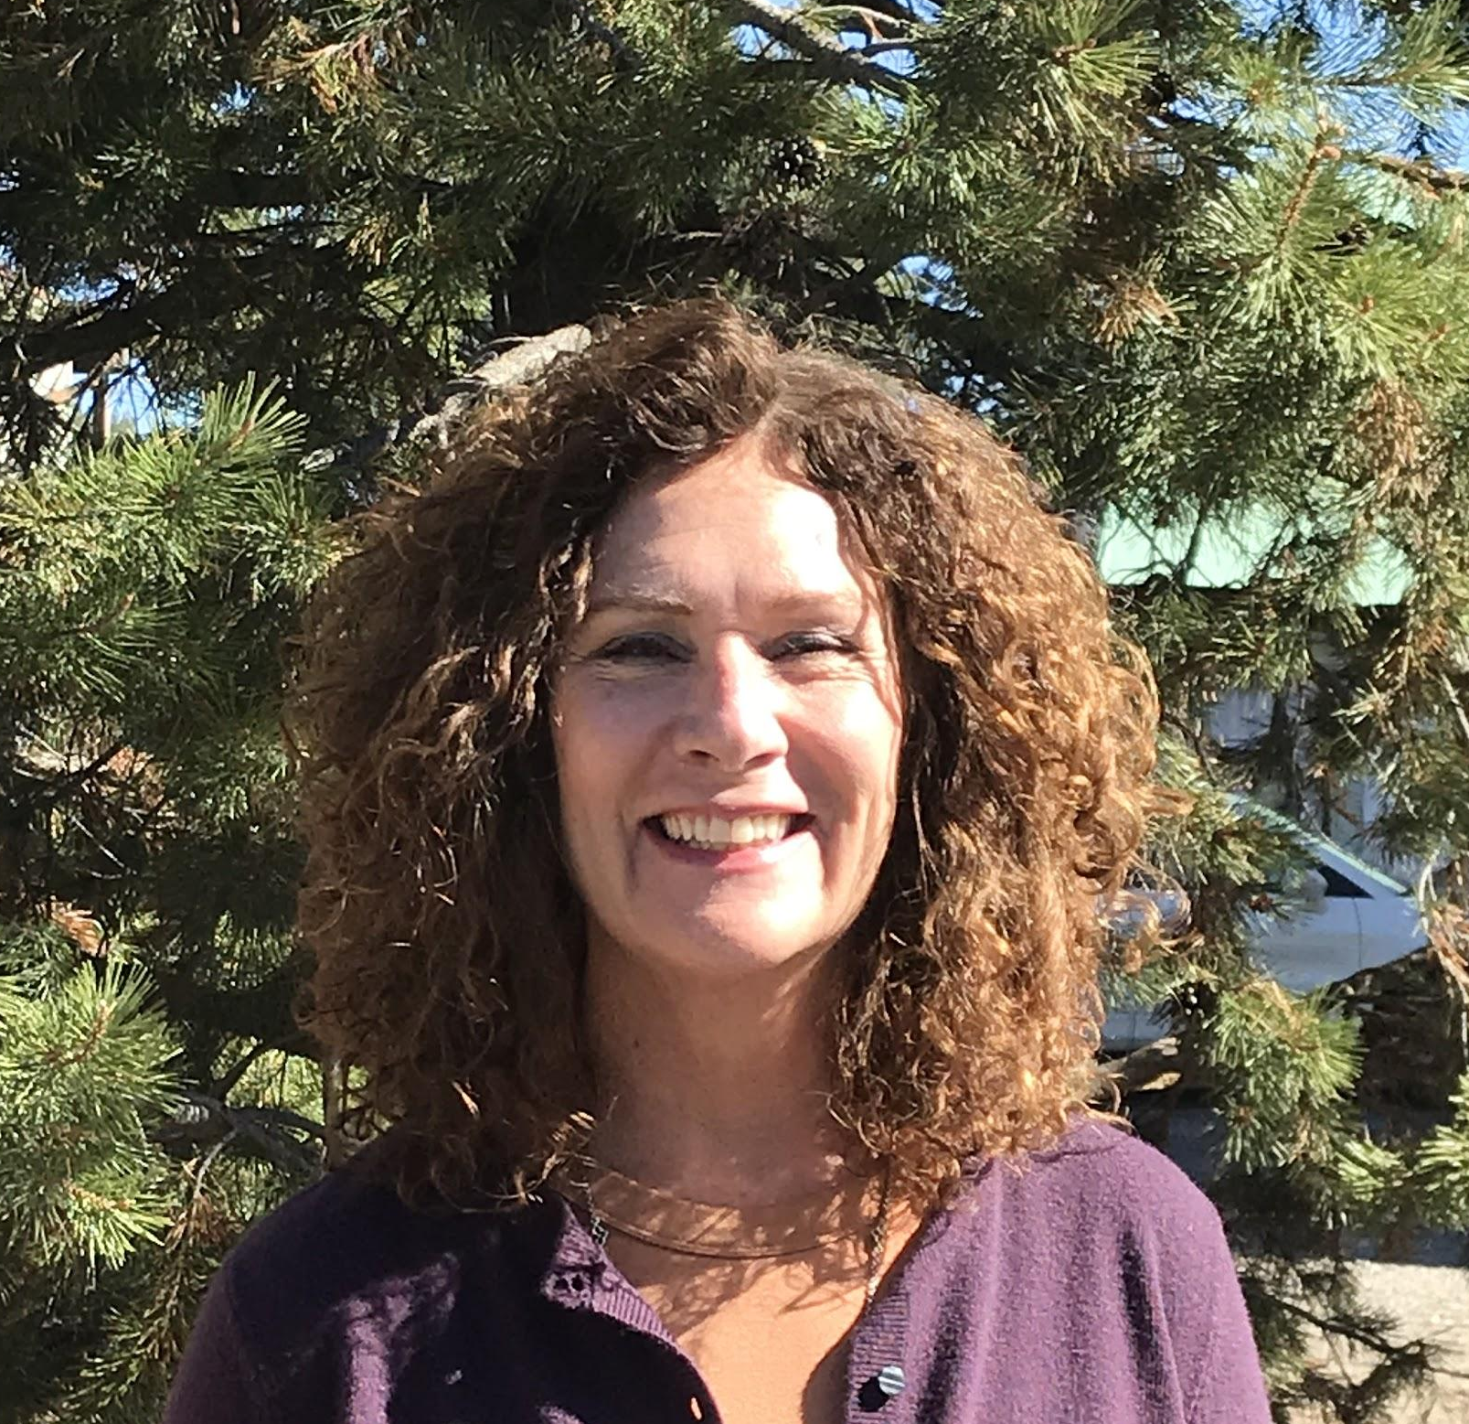
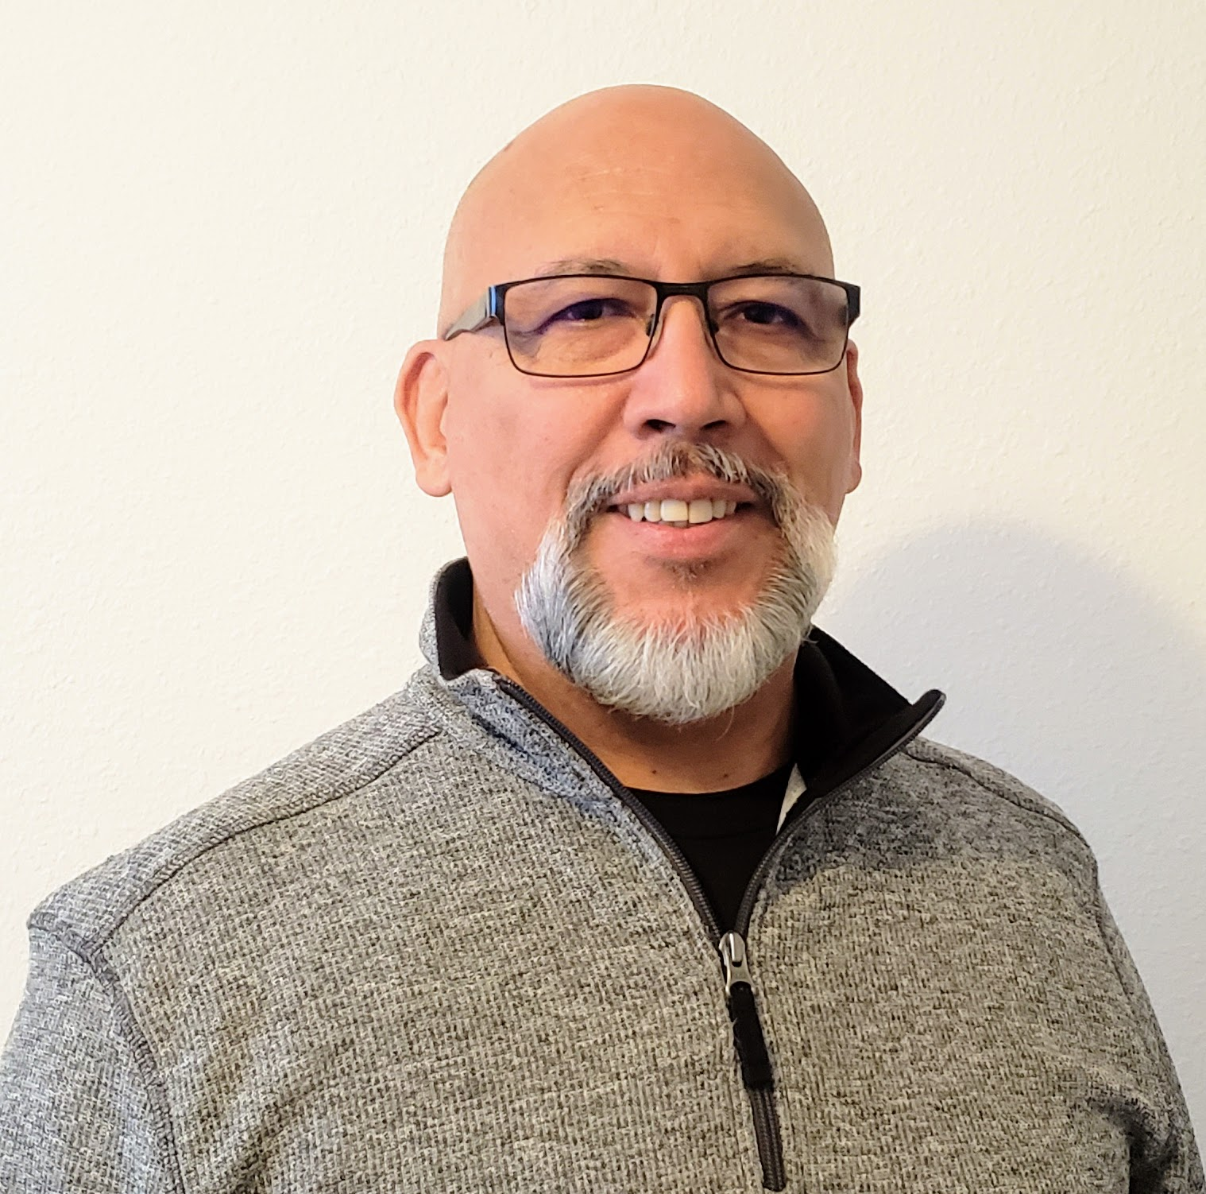
BOARD AND STAFF
HANNAH SULLIVAN,
CHAIR
ALEX MOURELATOS
BILL AUSTIN
BOB RICHARDS
GEOFF EDELSTEIN
ERIN KILMER
EMILY GENDRON
JERUSHA HALL
KELLEY CARROLL
KRISTIN YORK
LAUREN OBRIEN
TOM POWELL
WALLY AUERBACH
STACY CALDWELL,
CEO
ALISON SCHWEDNER
CAROLINE CRAFFEY
DEB RYAN
KATHY WHITLOW
KRISTINA KIND
PHYLLIS MCCONN
SERGIO NEVEL
TIMEA GRISET
Notes:
Stacy

Slide 5
what we do
Community Scholarships
Grant-Making
To Nonprofits
Market-based Solutions for Forest Health
Family Strengthening through CCTT
Emergency Response
Fund
Expand Housing
for Local Workforce
Notes:
Stacy

Slide 6
OUR INITIATIVES
STRENGTHEN FAMILIES
through CCTT
45+ agencies collaborating
Backbone to 3 Collective Impact Models
Community House - Building for Integrated Services
Community Report Card
Public/Private Partnerships in Mental Health
ACCELERATE HOUSING SOLUTIONS
Mobilized 29+ stakeholders
Regional policy agenda
411 units in development
Attracted nearly $50 million for projects
Produced 6 white papers/policy
Secured financing for Affordable Housing
PROTECT OUR FORESTS
Define Metrics
Catalyze sustainable economies
Create new jobs
Save acres of forests
Prevent forest fire
IMPACT INVESTING
Local & Leveraged Investing - Community House
Public/Private - Affordable Housing
Incubate B-Corps = Second Homes
Green Jobs - Equipment & Transport for Biomass Forest Venture Lab
Notes:
Stacy

Slide 7
COMMUNITY IMPACT
Housing Loss - Real estate sales and median home prices are rising
Economic Uncertainty- 60% are tourism based jobs
Impact on Kiddos - Distance Learning & Lack of child care
Hunger Relief - Food insecurity
Behavioral Health - Community stress / collective trauma / Substance Abuse
Social Injustice - Political Unrest
Notes:
Alison
Housing Loss - Housing crisis before COVID. Locals squeezed out housing market Real estate sales and median home prices are rising, no shelters. Single Family Median home prices have risen approximately 29% in the 3rd quarter of 2020 compared to 2019. (data source: Tahoe Sierra Board of Realtors MLS 3rd quarter sales analysis for 2020 and 2019. Truckee prices have risen 29%; North Lake prices have risen 28%).
Economic Uncertainty- 60% are tourism based jobs. While many places of business were really busy over the holidays, many of our hotel staff, house cleaners, restaurant workers unable to work
Impact on Kiddos - Kids have experienced increased stress, anxiety chidcare facilities have closed, serve fewer kids because provider - kid ratio has lessened, number of childcare centers have had to quarbatune bc of COVID exposure, and when there is no childcare, parents cant work
Hunger Relief - Food insecurity. 200 % increase
Behavioral Health - Community stress / collective trauma / Substance Abuse. 30 %
Social Injustice - Political Unrest
Placer County Meeting Stats Eastern Placer County has seen a 31% decrease in permanent population from 2000-2018.From 15,000 to a little over 10,000. During the same time, key drive markets have grown since 2000: Reno increased 42%, Sacramento 31%, and the Bay Area 14%. Well over 80% are second home owners.
sss

Slide 8
nonprofit IMPACT
Loss of fundraising capability - $7m+
Loss of staff capacity and operational uncertainty
High stress/High stakes
Increased requests for data and experts
Pivot: Virtual “office” and programs
Increased demand in response programming
Board engagement shifting
Org vision may change...creativity is key
Incorporating Race and Equity in the work
Notes:
Phyllis

Slide 9
Collective Giving
$795,000 - Emergency Response Fund - Safety-Net for rounds 1 & 2, broader nonprofit community
$995,000 - Placer Shares - Safety-Net & Broader Nonprofit
$359,095 - Competitive Grant Cycle
$428,821 - Give Back Tahoe
$1,038,000 - TTCF & Community Scholarships
$2m+ Donor Advised Funds
5.6M+ DISTRIBUTED
Notes:
Phyllis
Strategic flexible emergency funding with trust based philanthropy
Believe that the more flexible and trust based the better to serve the community
NOt going into relationships blindly - decades of relationship, so undergirding trust

Slide 10
Regional Stewardship
Notes:
Regional collaboration, strategy & alignment to steward $$, distribution of CARES Act Relief Funds, biggest investment in safety net, agencies are better equipped to scale

Slide 11
Notes:
Available in Spanish as well

Slide 12
Notes:
Available in Spanish as well

Slide 13
EMERGENCY RESPONSE FUND
Provides flexible resources to our nonprofits
Bolsters our Safety-net
Helps out our community!
www.ttcf.net “donate now”
Notes:
Phyllis
Strategic flexible emergency funding with trust based philanthropy
Believe that the more flexible and trust based the better to serve the community
NOt going into relationships blindly - decades of relationship, so undergirding trust

Slide 14
OPPORTUNITIES TO ENGAGE
January 13 | 5pm: Welcome Wagon
January 15 | 8-11am: Mountain Housing Council
January 27 | 4-5:30pm: Forest Futures Salon
Jan 22 -Feb 12 | Nonprofit workshops for strategic planning

Slide 15
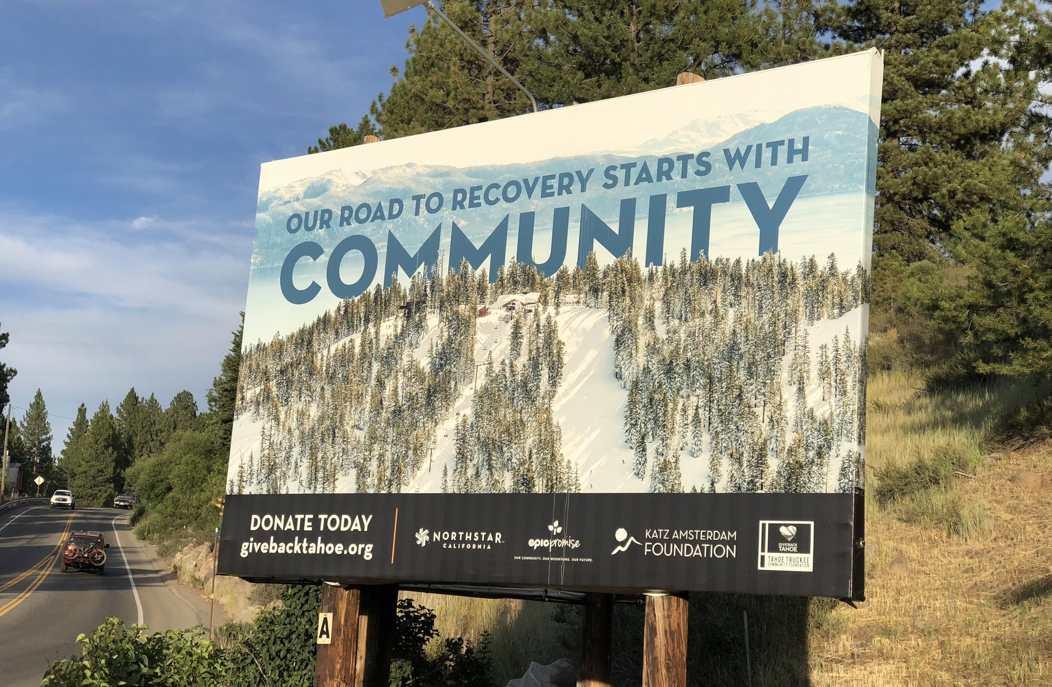
THANK YOU!
VISIT US 11071 Donner Pass Rd Truckee, CA
96161
MAIL P.O. Box 366 Truckee, CA
96160
EMAIL
info@ttcf.net
@ttcfgives

